Slide 1
Make & Merge Branches!
Hands-on C

Slide 2
Create a New Branch
Branches
$ git checkout -b develop
Switched to a new branch 'develop'
$ git branch
* develop
master
By default, the repository has the master branch
Create a branch named develop
git checkout -b <branch name>
command to create a new branch & switch to it
git branch
command to view a list of branches
current branch has the asterisk (*)

Slide 3
Changing develop Branch
Branches
$ touch develop_file.md
$ git add develop_file.md
$ git commit -m "develop only"
[develop f946eb0] File only in develop branch
1 file changed, 0 insertions(+), 0 deletions(-)
create mode 100644 develop_file.md
$ git status
On branch develop
nothing to commit, working tree clean
$ git push -u origin develop
While being in the develop branch, create a file.
Run git add and git commit to save it to the local repo.
Run git status to confirm the changes.
Run git push to push the changes to GitHub repo

Slide 4
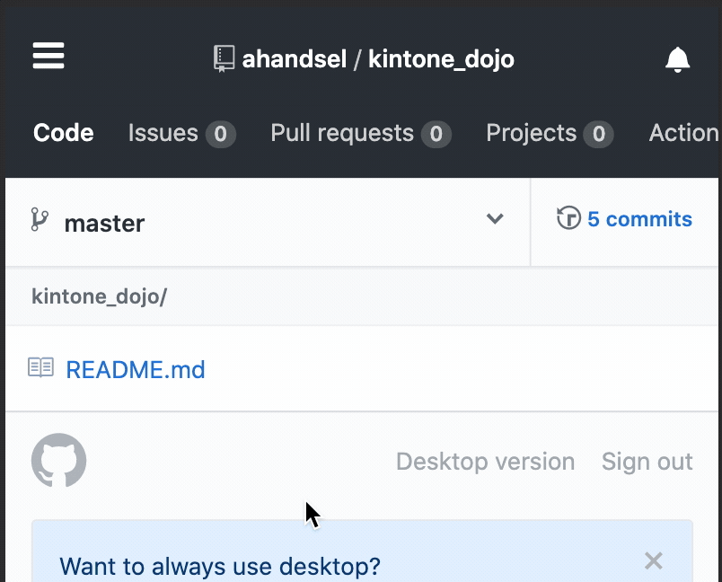
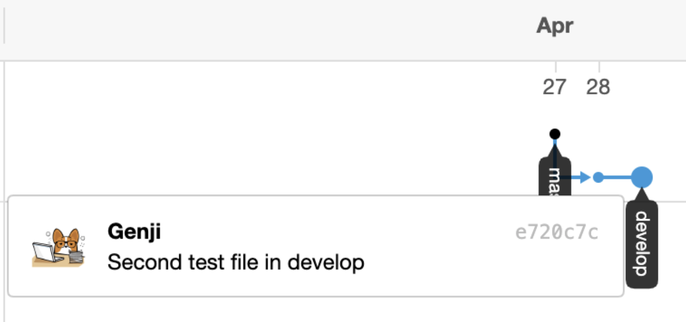
Confirming the Change on GitHub
Branches
Only the develop branch included the new file
Add another file in develop branch
Then view the Network graph
https://github.com/USER/REPO/network

Slide 5
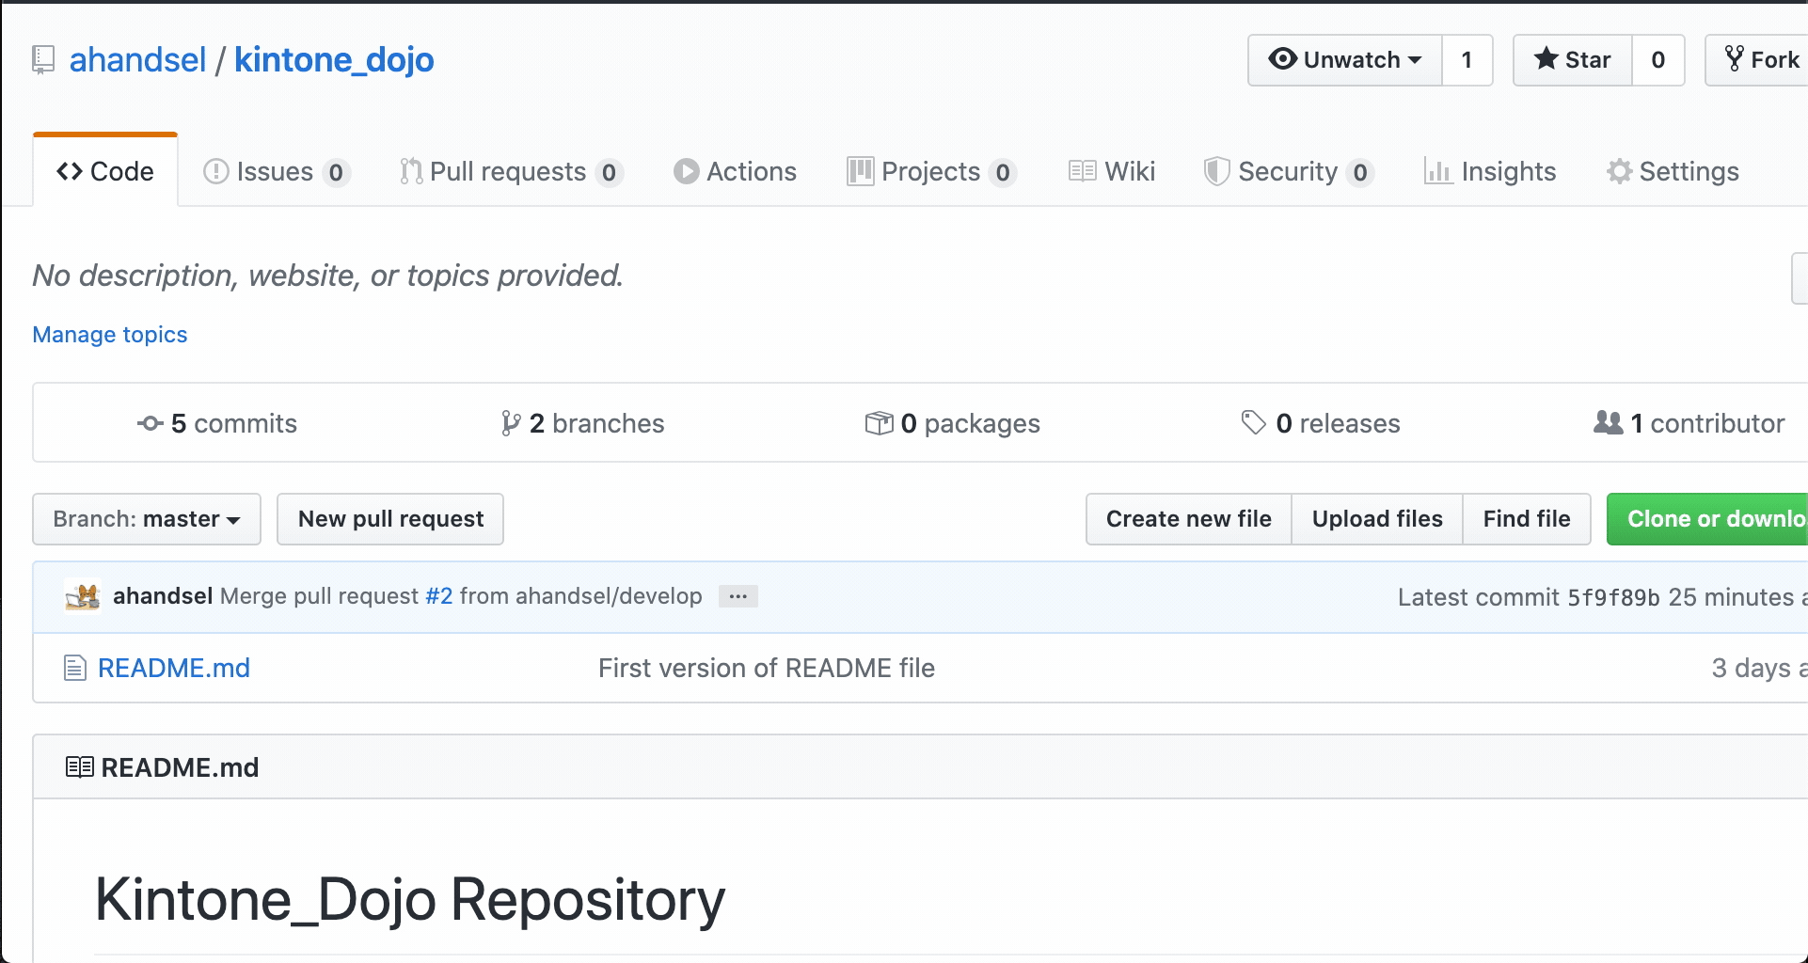
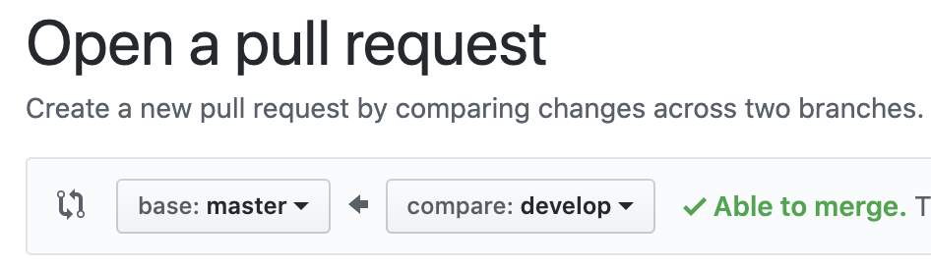
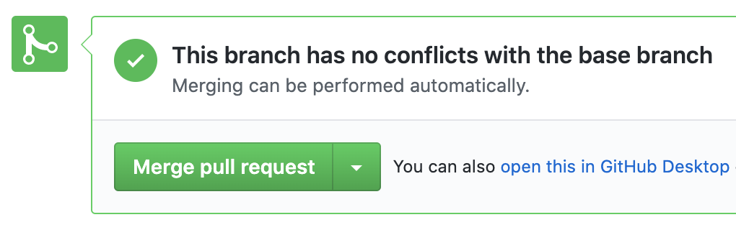
Create & Merge Pull Request
Branches
Pull Requests shows others your changes without actual modifying
useful for code review
On GitHub, create the pull request to merge develop -> master branch
Confirm the changes and Merge Pull request
This results in master branch having the two new files!

Slide 6
GitHub repo → Update Local repo
Branches
$ git checkout master
Switched to branch 'master'
Your branch is behind 'origin/master' by 4 commits & can be fast-forwarded
(use "git pull" to update your local branch)
$ git pull origin master
remote: Enumerating objects: 1, done.
remote: Counting objects: 100% (1/1), done.
remote: Total 1 (delta 0), reused 0 (delta 0), pack-reused 0
Unpacking objects: 100% (1/1), 631 bytes | 210.00 KiB/s, done.
From https://github.com/ahandsel/kintone_dojo
* branch master -> FETCH_HEAD
5f9f89b..1438ca5 master -> origin/master
Updating d775d42..1438ca5
Fast-forward
2nd_file.md | 0
develop_file.md | 0
2 files changed, 0 insertions(+), 0 deletions(-)
create mode 100644 2nd_file.md
create mode 100644 develop_file.md
$ git branch -d develop
Deleted branch develop (was c6e6c83).
$ git branch
* master
$ git checkout master
$ git pull origin master
$ git branch -d develop
$ git branch
Currently, your GitHub repo is ahead of the local copy
Use git pull command to address this
git pull origin master
pull the latest repo version from GitHub to the local repo

Slide 7
What are branches?
Overview of Hands-on C

Slide 8
Git Branches
Branches
What are branches?
Why use branches?
movable pointer to a commit
mechanism that manages multiple timelines, allowing for changes without impacting the main line
git checkout
command to switch branches
git branch -d <branch-name>
command to delete branches
allows for a separation between stable, in-development, and experimental changes
Example: This GitHub Slides
Each Hands-on and concept section can be a branch.
Each can be developed in parallel.
Notes:
https://git-scm.com/book/en/v2/Git-Branching-Branches-in-a-Nutshell

Slide 9
Branches - Website
Branches
master branch contains the 'live' code that runs the website.
changes in master impacts users
Two coders want to modify the website at the same time. Make 3x branches:
master → live code
feature_A → for coder A to modify
feature_B → for coder B to modify
Once the code developments are done, merge the branches.

Slide 10
Git Pull vs Push
Git Pull vs Push
git push
git pull
the 'upload' command
"Push" is forcing the changes to the target repo.
[ your code ] -- pushing --> [target]
A "push request" would be the target repo requesting you to push your changes.
the 'download' command
"Pull" is the target repo grabbing your changes
[ your code] }-- pulling -- [target]
A "pull request" is you requesting the target repository to please grab your changes.

